Slide 1
Measuring Internal Product Size
Prof Maheswari S
VIT Chennai

Slide 2
Aspects of software size
Each product of software development is a physical entity; as such, it can be described in terms of its size.
Ideally, we want to define a set of attributes for software size analogous to human height and weight.
That is we want them to be fundamental, so that each attribute captures a key aspect of software size.

Slide 3
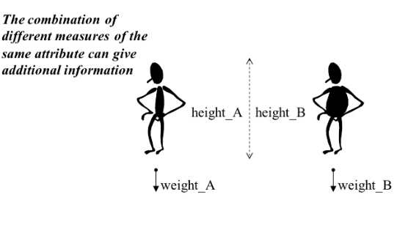

Slide 4
Types
length: physical size of the product
functionality: functions supplied by the product to the user
complexity
problem complexity: the complexity of the underlying problem
algorithmic complexity: efficiency of the algorithm
structural complexity: algorithm structure (Chapter 8)
cognitive complexity: understandability of software (not treated here)
When measuring length and functionality it is sometimes important to observe reuse.

Slide 5
Length, Code
We must address how the following is handled:
blank lines
comment lines (CLOC)
data declarations
lines that contains several separate instructions
It is useful to separate comment lines and other lines (NCLOC),
so that
total length (LOC) = NCLOC + CLOC
The entity CLOC/LOC is then a measure of the density of comments in a program

Slide 6

Organization – Use of Length

Slide 7

Measuring length only with in project team

Slide 8
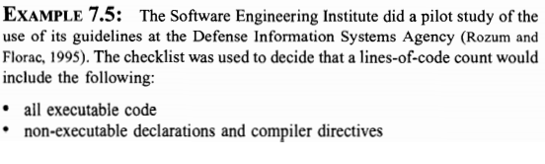
Example

Slide 9
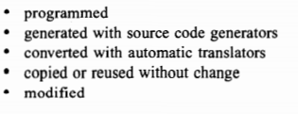
Check List

Slide 10
Advantages
Simple and automatically measurable
Correlates with programming effort (& cost)

Slide 11
Disadvantages of LOC
Vague definition
Language dependability
Not available for early planning
Developers’ skill dependability
Encouraging “sumo” development!

Slide 12
Halstead Metrics

Slide 13
Halstead Metrics
Maurice Halstead’s Theory (1971~1979):
A program P is a collection of tokens, composed of two basic elements:
Operands and operators
Operands are variables, constants, user defined functions
Operators are defined operations in a programming language (language constructs)

Slide 14
Halstead Metrics
Language and programmer dependent
Halstead’s Metrics
n₁ - number of distinct operators
n₂ - number of distinct operands
N₁ - total number of operators
N₂ - total number of operands

Slide 15
How to identify operands
IDENTIFIER - all identifiers that are not reserved words
TYPESPEC (type specifiers) - Reserved words that specify type: bool, char, double, float, int, long, short, signed, unsigned, void
CONSTANT - Character, numeric or string constants.

Slide 16
How to identify operator?
SCSPEC (storage class specifiers) - words that specify storage class: auto, extern, inline, register, static, typedef, virtual, mutable.
TYPE_QUAL (type qualifiers) - Reserved words that qualify type: const, friend, volatile.
RESERVED - break, case, class, continue, default, delete, do, else, enum, for, goto, if, new, operator, private, protected, public, return, sizeof, struct, switch, this, union, while, namespace, using, try, catch, throw, const_cast, static_cast, dynamic_cast, reinterpret_cast, typeid, template, explicit, true, false, typename.
OPERATOR –
! != % %= & && || &= () * *= + ++ += , - -- -= -> . ... / /= : :: < << <<= <= = == > >= >> >>= ? [ ] ^ ^= { } | |= ~

Slide 17
Example 1
if (k < 2)
{
if (k > 3)
x = x*k;
}

Slide 18
Example 2
Z = 0; while (X > 0 ) Z = Z + Y ; X = X - 1 ; print (Z) ;

Slide 19
Void sort( int*a, int n ) {
Int i, j, t;
if( n <2 )
return;
for( i=0 ; i <n-1; i++) {
for( j=i+1 ; j <n ; j++) {
if( a[i] > a[j]) {
printf(“inside if “);
t=a[i];
a[i] =a[j];
a[j]=t;
}
}
}
}

Slide 20
Halstead’s metrics
Program length: N = N₁ + N₂
Program vocabulary: n = n₁ + n₂
Estimated length: N’ = n₁ log₂ n₁ + n₂ log₂ n₂
Purity ratio: PR = N’/N
Volume: V = N log₂ n
Difficulty D = ( n1 / 2 ) * ( N2 / n2 )
Program effort: E=D*V

Slide 21
#include<stdio.h>
void hibernate(void)
{
long i;
for(i =0; i<1000000; i=i+1)
{
printf(" A long hibernate...\n");
}
}
void nap(void)
{
printf(" Just a short nap!\n");
}
int main()
{
printf("Take a nap!\n");
nap();
printf("Go to hibernate!\n");
hibernate();
}

Slide 22
public class Class1 {
public void x(boolean v) {
int i;
if (v) {i = 1;} else {i = 2;}
switch(i){
case 1:
case 2:
default:; }
try {
while(v){
v = false;
int r = 1;
Boolean b = new Boolean(true);
i = i*i+r;
break;}
} catch (Exception e) {
throw e;
} }
}

Slide 23
Halstead Metrics

Slide 24
Halstead Metrics
Maurice Halstead’s Theory (1971~1979):
A program P is a collection of tokens, composed of two basic elements:
Operands and operators
Operands are variables, constants, user defined functions
Operators are defined operations in a programming language (language constructs)

Slide 25
Halstead Metrics
Language and programmer dependent
Halstead’s Metrics
n₁ - number of distinct operators
n₂ - number of distinct operands
N₁ - total number of operators
N₂ - total number of operands

Slide 26
How to identify operands
IDENTIFIER - all identifiers that are not reserved words
TYPESPEC (type specifiers) - Reserved words that specify type: bool, char, double, float, int, long, short, signed, unsigned, void
CONSTANT - Character, numeric or string constants.

Slide 27
How to identify operator?
SCSPEC (storage class specifiers) - words that specify storage class: auto, extern, inline, register, static, typedef, virtual, mutable.
TYPE_QUAL (type qualifiers) - Reserved words that qualify type: const, friend, volatile.
RESERVED - break, case, class, continue, default, delete, do, else, enum, for, goto, if, new, operator, private, protected, public, return, sizeof, struct, switch, this, union, while, namespace, using, try, catch, throw, const_cast, static_cast, dynamic_cast, reinterpret_cast, typeid, template, explicit, true, false, typename.
OPERATOR –
! != % %= & && || &= () * *= + ++ += , - -- -= -> . ... / /= : :: < << <<= <= = == > >= >> >>= ? [ ] ^ ^= { } | |= ~

Slide 28
Example 1
if (k < 2)
{
if (k > 3)
x = x*k;
}

Slide 29
Example 2
Z = 0; while (X > 0 ) Z = Z + Y ; X = X - 1 ; print (Z) ;

Slide 30
Void sort( int*a, int n ) {
Int i, j, t;
if( n <2 )
return;
for( i=0 ; i <n-1; i++) {
for( j=i+1 ; j <n ; j++) {
if( a[i] > a[j]) {
printf(“inside if “);
t=a[i];
a[i] =a[j];
a[j]=t;
}
}
}
}

Slide 31
Halstead’s metrics
Program length: N = N₁ + N₂
Program vocabulary: n = n₁ + n₂
Estimated length: N’ = n₁ log₂ n₁ + n₂ log₂ n₂
Purity ratio: PR = N’/N
Volume: V = N log₂ n
Difficulty D = ( n1 / 2 ) * ( N2 / n2 )
Program effort: E=D*V

Slide 32
#include<stdio.h>
void hibernate(void)
{
long i;
for(i =0; i<1000000; i=i+1)
{
printf(" A long hibernate...\n");
}
}
void nap(void)
{
printf(" Just a short nap!\n");
}
int main()
{
printf("Take a nap!\n");
nap();
printf("Go to hibernate!\n");
hibernate();
}

Slide 33
public class Class1 {
public void x(boolean v) {
int i;
if (v) {i = 1;} else {i = 2;}
switch(i){
case 1:
case 2:
default:; }
try {
while(v){
v = false;
int r = 1;
Boolean b = new Boolean(true);
i = i*i+r;
break;}
} catch (Exception e) {
throw e;
} }
}

Slide 34
Complexity – Big O notation
Notation - O(n)
Constant Complexity
Logarithmic Complexity
Linear Complexity
Quadratic Complexity
Exponential Complexity

